Slide 1


Slide 2
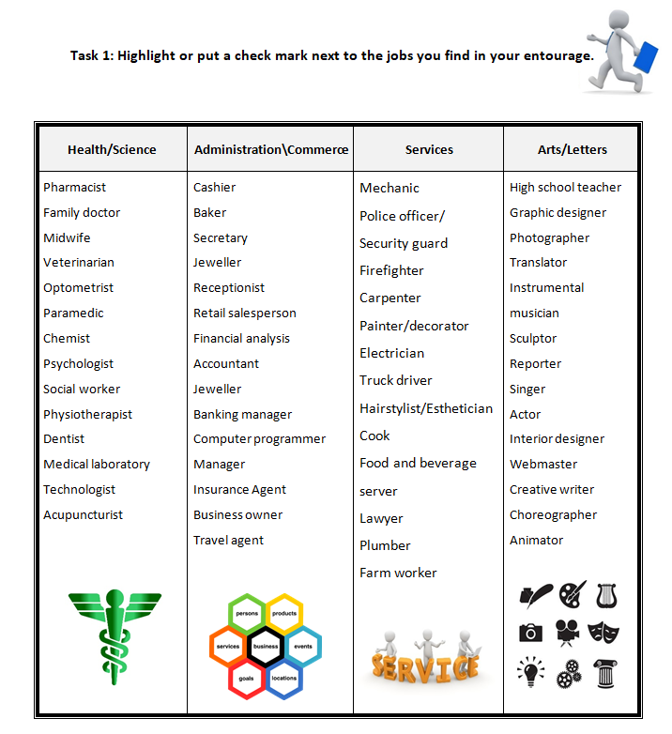

Task 1

Slide 3
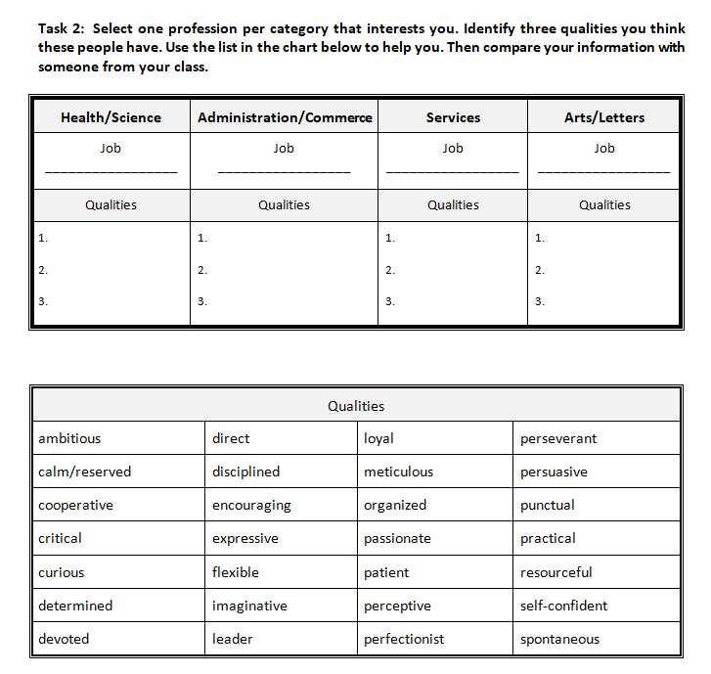
Task 2

Slide 4
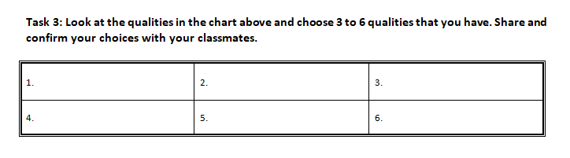
Task 3

Slide 5
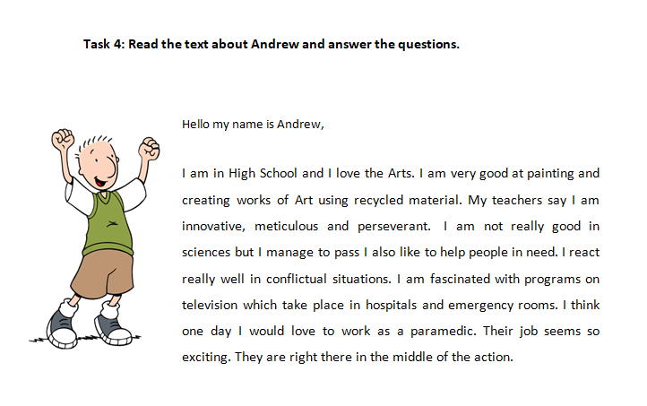
Task 4

Slide 6
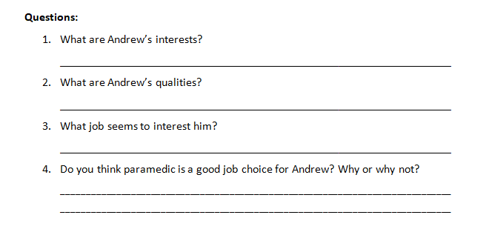
Task 4

Slide 7
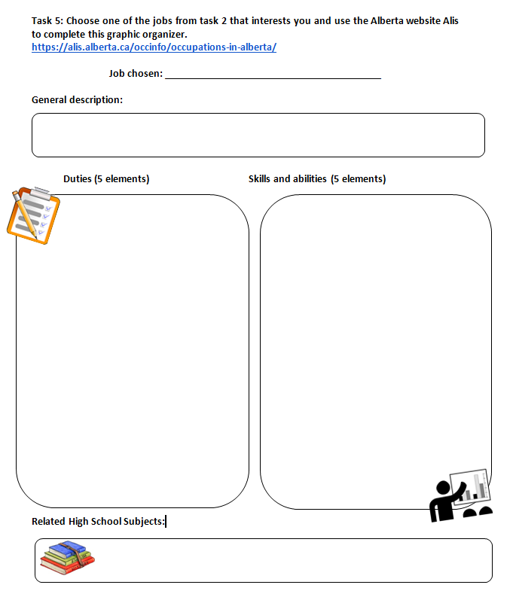
Task 5

Slide 8
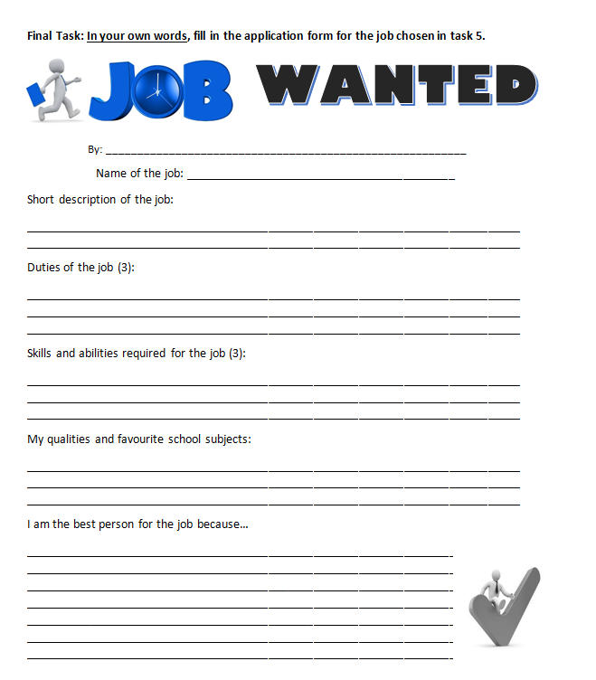
Final
Task

Slide 9
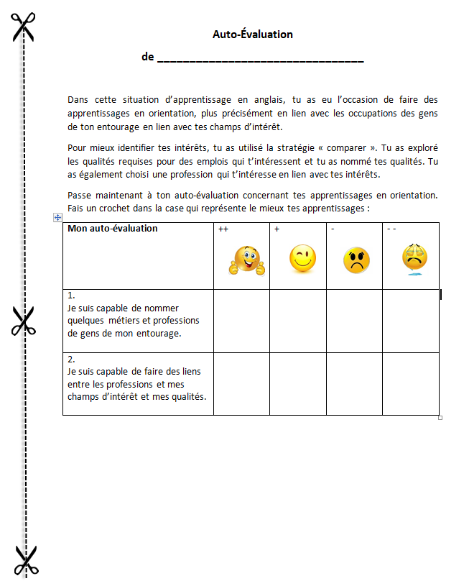
Auto-Évaluation

Slide 10
Credits
Special thanks to all the people who made and released these awesome resources for free:
Presentation template by SlidesCarnival
Photographs by Startupstockphotos

